Slide 1
Reference Books:
1) Software Engineering
Author: Roger S. Pressman
2) Software Engineering, ^{6th} edition
Author: Lan Sommerville
3) Systems Analysis and Design
Author: Elias M. Awad
4) Systems Analysis and Design
Author: R. J. Thierauf

Slide 2
Software
It is a collection of instructions (computer programs) which provide desired features, functions and performance when executed
  It includes data structures to manipulate information
  It includes Documents to describe the operations and programs
  A Software is a collection of Objects
OO Analysis
The intent is to define all classes, the relationship and behavior associated with them that are relevant to the problem to be solved using the software to be developed.
Builds a class-oriented model rather than input-processing-output (information flow) model.
OOA tasks
Basic user requirements must be communicated between the customer and the software engineer
Classes must be identified with the attributes and operations defined
Class hierarchy is defined
Object-to-object relationship is defined
Object behavior must be modeled

Slide 3
OOA tasks
Tasks 1 through 5 are repeated until the model is complete.
Attributes
These are a collection of data items which contain values to construct an object to describe a class of those objects.
e.g., color of a car.
Class
It is a generalized description, e.g., a template, pattern to describe a collection of similar objects.
Encapsulates data and procedural abstractions required to describe the content and behavior of some real world entity.
e.g. Furniture to define chairs, tables etc.

Slide 4
Objects
These are instances of a specific class
Uses the attributes and operations of a class
e.g., a chair
Operations
Services provided by a class
Represents the behavior of a class
e.g., display() is an operation of a Furniture class
Analysis Models
Scenario-based modeling: use case diagram, activity diagram, sequence
diagram
Flow-oriented modeling: data flow diagram, control flow model
Class-based modeling: class diagram
Class-Responsibility-Collaborator (CRC) modeling: CRC diagram
Scenario-based modeling
Developing Use Cases
It describes a specific usage scenario with respect to an actor
Depicts the software or system from the end users point of view
e.g., set alarm is a use case for the Home owner actor in SafeHome software
See Fig. 8.6

Slide 5
OO Analysis, Flow-oriented modeling
Actor
It is anything that communicates with the system and that is external to the system
People or devices that use the system
Represent the roles that people or devices play as the system operates
e.g. Homeowner See Fig. 8.6 p223
Use case writing
The functions or activities performed by specific actor are listed from the list of required system functions
conversations with customers/end users
evaluating activity diagrams
Flow-oriented modeling
Provide insight into system requirements and flow
Data-flow modeling is one of the most widely used analysis notations
Data-flow diagram (DFD) is not a formal part of Unified Modeling Language (UML), it can be used to complement UML diagrams.

Slide 6
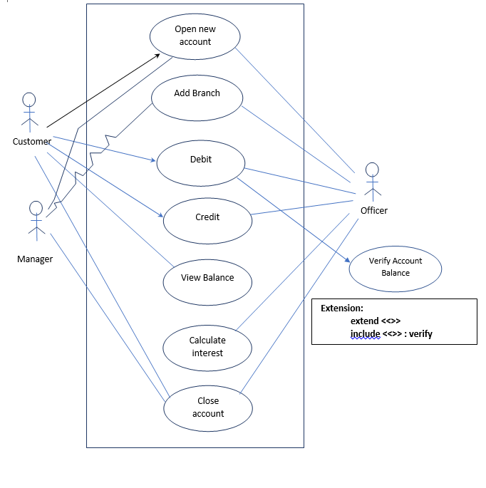

Slide 7
Data-flow diagram (DFD)
It is a way of expressing system requirements in a graphical form for modular
Design.
Identify major transformations that will become programs in system design
Enables the software engineer to develop models of the information domain and functional domain
Allows functional decomposition of the system, refinement of data as it moves through the processes of the application
DFD symbols
Square: source or destination of system data
Arrow: data flow
Circle (Bubble): represents a process that transforms incoming data flow(s) into outgoing data flow(s)
open rectangle: data store
DFD levels
Three types: i) Level 0 ii) Level 1 iii) Level 2
Level 0 DFD
It is a context-level DFD
It represents the system as a whole
It is hierarchical, i.e., subsequent DFDs (Level 1, Level 2) refine the context diagram providing increasing detail with each subsequent level.

Slide 8
Creating DFD model
Level 0 DFD depicts the software/system as a single bubble
The primary input and output to the bubble must be maintained
DFD refinement begins by isolating candidate processes, data objects and data stores to be used in the next level
All arrows and bubbles are labeled with meaningful names
Information flow continuity must be maintained
Primary external entities (boxes: data sources/destination) produce information for use by the system and consume information generated by the system
Level 0 DFD is expanded to a Level 1 DFD and a Level 1 DFD can in turn be expanded to a Level 2 DFD in detailing a process.
All nouns/noun phrases and verbs/verb phrases are identified from the first requirements narrative text of the candidate system.

Slide 9
DFD
Identifying DFD processes and data sources
Identified verbs are the processes in the DFD
Nouns are external entities (boxes), data or control objects (arrows), or data
stores (open rectangle)
The refinement of DFDs continues until each bubble performs a simple
function, i.e., until the process represented by the bubble performs a
function that would be easily implemented as a program component
(function).

Slide 10
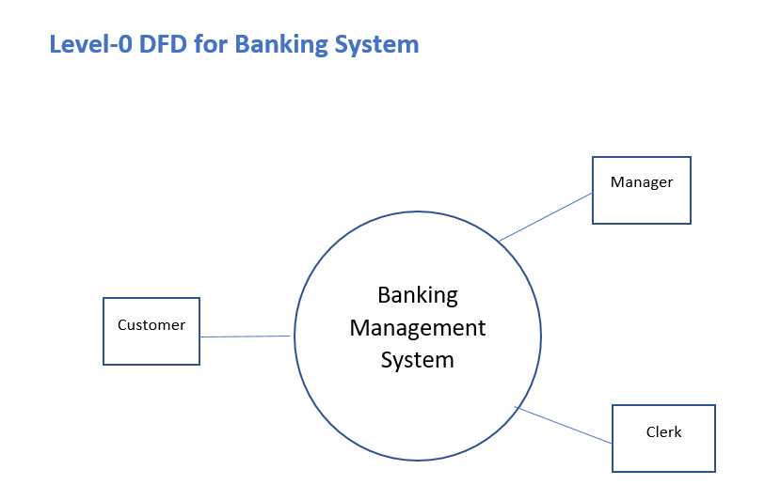

Slide 11
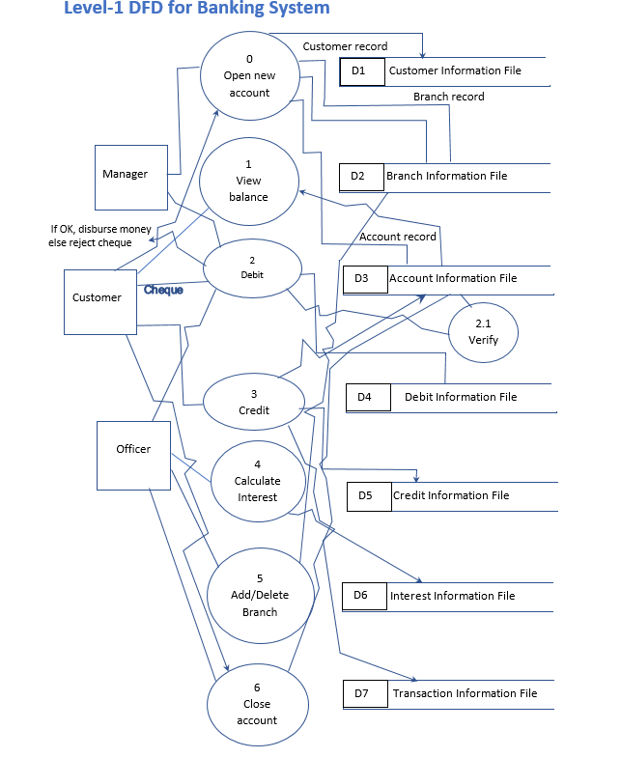

Slide 12
Class-based modeling
Identifying analysis classes
Several rules are used to identify classes of objects of a candidate system as
described below.
  External entities: other systems, devices or people etc.
  Things: reports, displays, letters etc.
  Occurrences or events: property transfer, robot movement etc.
  Roles: sales person, manager etc.
  Organizational units: group, team etc.
  Places: floor, play ground etc.
  Structures: computers, vehicles etc.
Specifying attributes
Attributes describe and define a class of the candidate system
From a use case, select those things that belong to a class
What data items fully define a class
e.g., account name of a bank account

Slide 13
Class-based modeling
Defining operations
It defines the behavior of an object
Four types: i) to manipulate data, e.g., adding, deleting etc
ii) to perform computation
iii) to inquire the state of an object
iv) to monitor an object
See Fig. 8.13, 8.14
CRC modeling
Class-responsibility-collaborator modeling provides a simple means for
identifying and organizing classes that are relevant to the system
A CRC model is a collection of standard index card that represent classes
Responsibilities: Attributes and operations that are relevant for the class
Collaborators: Classes that are required to provide a class with the information
needed to complete a responsibility.
Collaboration: It implies either a request for information or a request for some
action.
See Fig. 8.15

Slide 14
Class-based modeling
Link and Associations
Link: It is a physical or conceptual connection among objects.
Association: It is a description of a group of links with common structure and
common semantics.
See Fig. 3.7 and 3.8
Generalizations and Inheritance
It is a relationship between a class (called the super class) and one or more
variations of this class (called subclasses).
Organizes classes by their similarities and differences
The super classes hold common attributes, operations and associations. The
sub classes add specific attributes, operations and associations.
The sub class is said to inherit the features of its super class
Generalization is called a is-a relationship
See Fig. 3.24

Slide 15
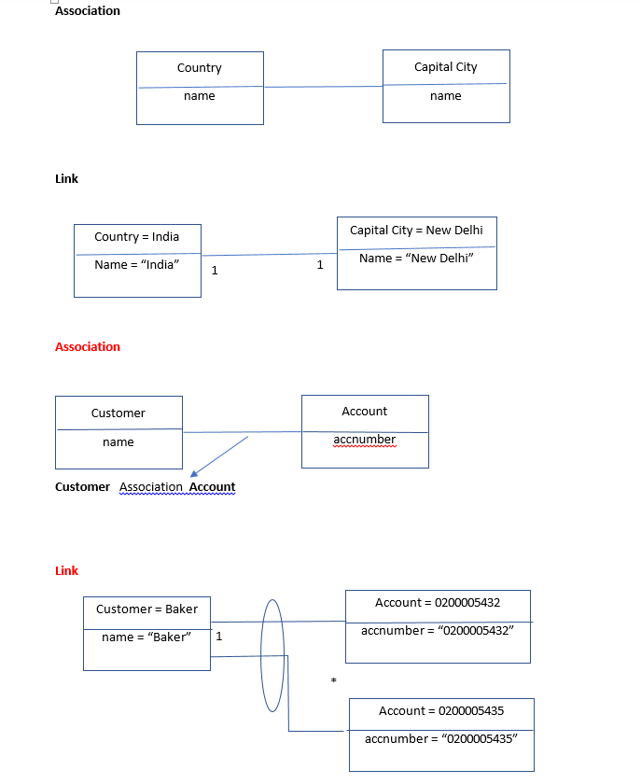

Slide 16
Class-based modeling
Generalization has three purposes:
to support polymorphism
to structure the description of objects
to support the reuse of code
Inheritance
It is the mechanism for sharing attributes, operations, and association via the
generalization/specialization relationship.
Specialization
It refers to the fact that the subclasses refine or specialize the super class
Polymorphism
Single function in different classes with inheritance among them
Variation in any form : no. of parameters, data types, argument, code etc.
E.g., getBalance() is a polymorphic operation in Bank Account classification

Slide 17
Bank Account Generalization/Specialization
public class Account
{
}
public class Savings extends Account
{
private double intRate;
…..
public double calcInterest()
{ //…….}
}
public class Current extends Account
{
}
public class Bank
{
public static void main(String args[])
{
Savings sav = new Savings();
Current cur = new Current();
sav.calcInterest();
cur. calcOverDraft();
}
}

Slide 18
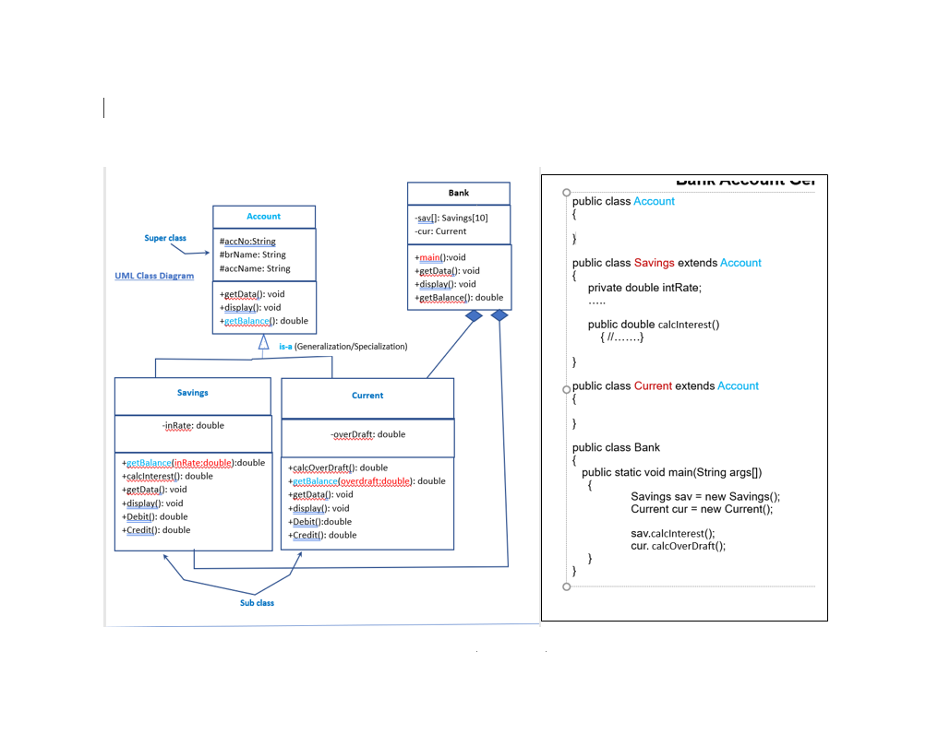

Slide 19
Class-based modeling
Aggregation
It is a strong form of association
An aggregate object is made of constituent parts
See Fig.
Composition
It is a form of aggregation with the following constraints:
A constituent part can belong to at most one assembly
it has a co-incidental lifetime with the assembly
See Fig.
Visibility
It refers to the ability of a method to reference a feature from another class
It has the possible values of
public (+)
protected (#)
private (-)
package (∼)

Slide 20
Class-based modeling
Any method can access public features
Only methods of the containing class and its descendants via inheritance can
access protected features
Only methods of the containing class can access private features
Methods of classes defined in the same package as the target class can
access package features.

Slide 21
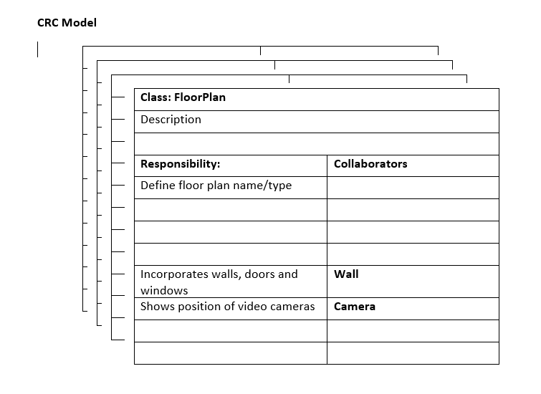

Slide 22
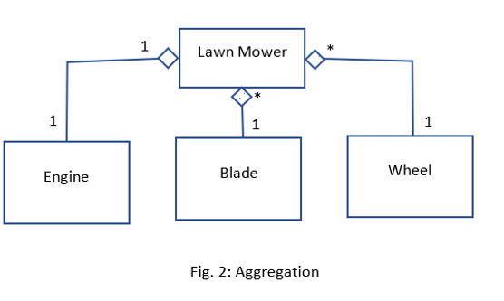

Slide 23
